Slide 1
SENTIMENT ANALYSIS WITH DEEP LEARNING
Manjunath D
Student/CSE
Dayanand Sagar University
Bangalore

Slide 2
Abstract
Every company wants to understand their customers. In the past, surveys were required to get an idea of how customers felt about products or services, but today, there are many conversations about brands and companies online.
It is impossible for companies to read thousands of feedbacks, so there is a need for automation of this process.

Slide 3
Problem statement
Automate the process of sentiment analysis with deep learning to measure the customer satisfaction and to avoid going through large amount of feedbacks manually .

Slide 4
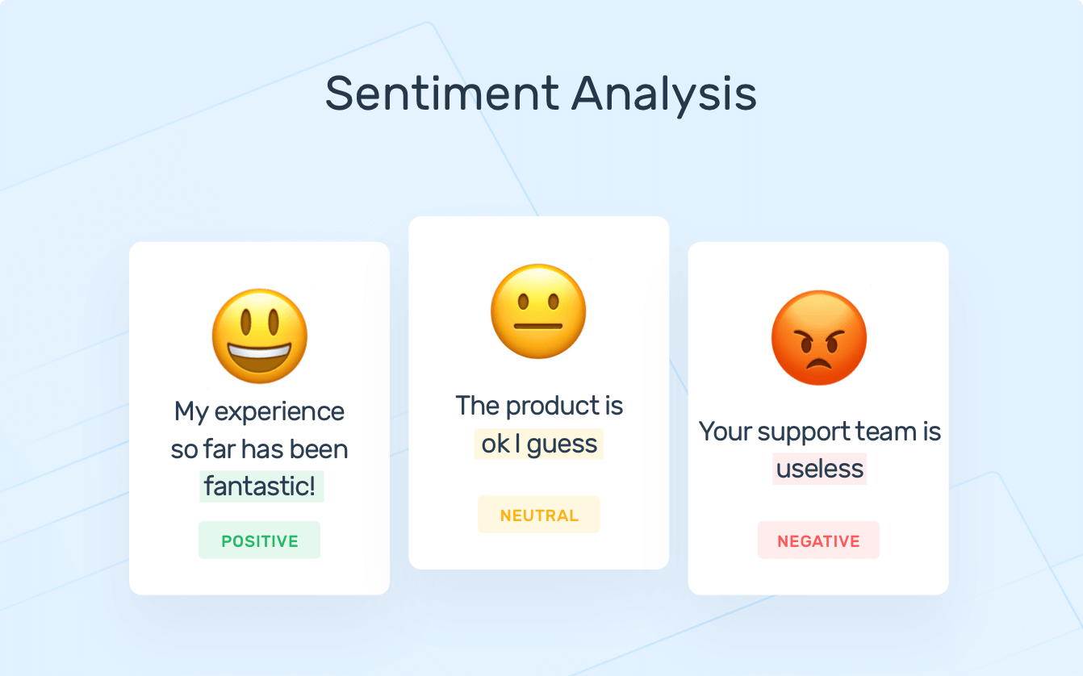
Introduction

Slide 5
Introduction
Sentiment analysis (or opinion mining) is a natural language processing (NLP) technique used to determine whether data is positive, negative or neutral. Sentiment analysis is often performed on textual data to help businesses monitor brand and product sentiment in customer feedback, and understand customer needs.

Slide 6
Proposed methodology
Remove URLs and email addresses from every single sample — because they won’t add meaningful value.
Remove punctuation signs — otherwise your model won’t understand that “good!” and “good” are actually meaning the same thing.
Lowercase all text — because you want to make the input text as generic as possible. “Good” , ”good” ,”GOOD” all these words are converted to “good”.
Remove stop-words — because they only add noise and won’t make the data more meaningful. Stop-words refer to the most common words in a language, such as “I”, “have”, “are” and so on.

Slide 7
Proposed methodology
Lemmatizing — This step is optional, but for most of data scientist considered as crucial. Lemmatizing generally returns valid words. This is how lemmatizers work: suppose you want to find the root word of ‘caring‘ ‘Caring’> Lemmatization > ‘Care’.
Transform dataset (text) into numeric tensors Usually referred as vectorization . like all other neural networks, deep-learning models don’t take input as raw text, they only work with numeric tensors.

Slide 8
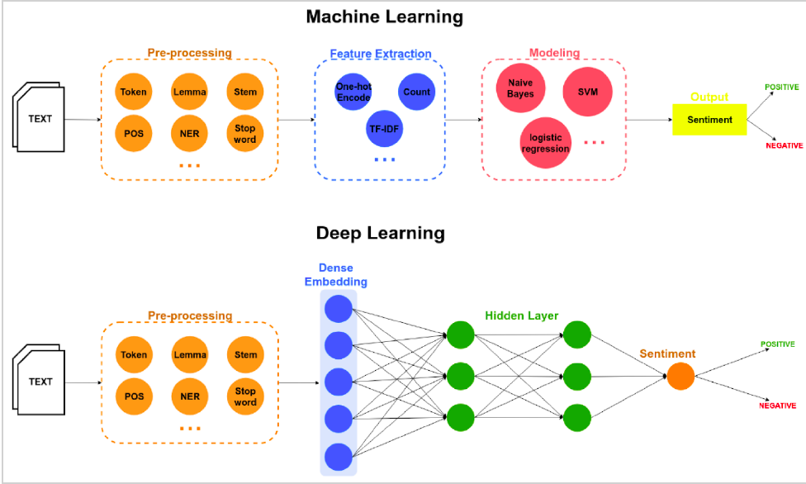
Proposed methodology

Slide 9
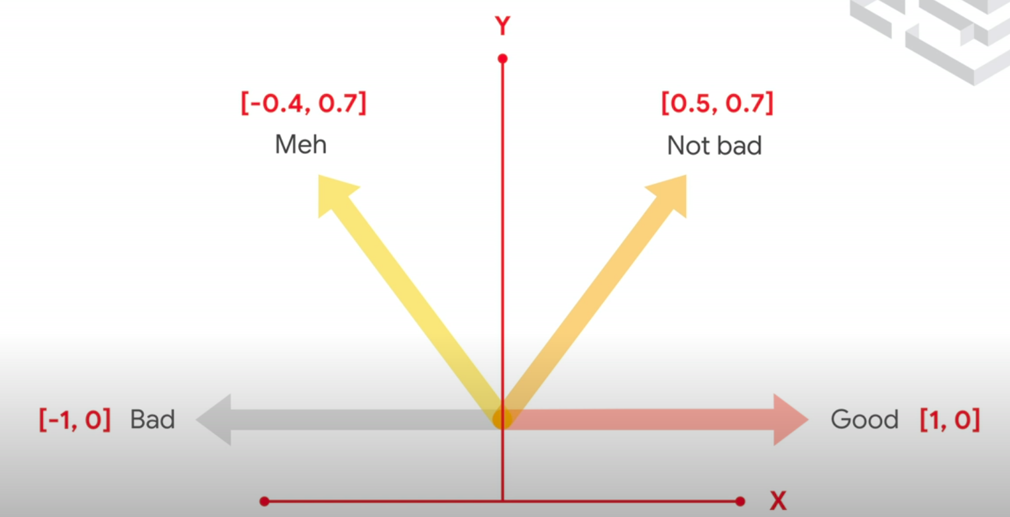
Proposed methodology
Embedding layer

Slide 10
Thank you
Thank you
Thank you

